Slide 1
Data Science
Session – 9
Date – 27th May, 2022

Slide 2
R - Excel File
Microsoft Excel is the most widely used spreadsheet program which stores data in the .xls or .xlsx format. R can read directly from these files using some excel specific packages. Few such packages are - XLConnect, xlsx, gdata etc. We will be using xlsx package. R can also write into excel file using this package.
Install xlsx Package
You can use the following command in the R console to install the "xlsx" package. It may ask to install some additional packages on which this package is dependent. Follow the same command with required package name to install the additional packages.
install.packages("xlsx")

Slide 3
R - Excel File
Verify and Load the "xlsx" Package
Use the following command to verify and load the "xlsx" package.
Reading the Excel File
The input.xlsx is read by using the read.xlsx() function as shown below. The result is stored as a data frame in the R environment.
# Verify the package is installed.
any(grepl("xlsx",installed.packages()))
# Load the library into R workspace.
library("xlsx")
# Read the first worksheet in the file input.xlsx.
data <- read.xlsx("input.xlsx", sheetIndex = 1)
print(data)

Slide 4
R - XML Files
XML is a file format which shares both the file format and the data on the World Wide Web, intranets, and elsewhere using standard ASCII text. It stands for Extensible Markup Language (XML). Similar to HTML it contains markup tags. But unlike HTML where the markup tag describes structure of the page, in xml the markup tags describe the meaning of the data contained into he file.
You can read a xml file in R using the "XML" package. This package can be installed using following command.
install.packages("XML")

Slide 5
R - XML Files
Input Data
Create a XMl file by copying the any data that is in the format of XML into a text editor like notepad. Save the file with a .xml extension and choosing the file type as all files(*.*).
You’ll find the input.xml file shared with you in dataset folder
File -> input.xml
Reading XML File
The xml file is read by R using the function xmlParse(). It is stored as a list in R.
# Load the package required to read XML files.
library("XML")
# Also load the other required package.
library("methods")
# Give the input file name to the function.
result <- xmlParse(file = "input.xml")
# Print the result.
print(result)

Slide 6
R - JSON Files
JSON file stores data as text in human-readable format. Json stands for JavaScript Object Notation. R can read JSON files using the rjson package.
Install rjson Package
In the R console, you can issue the following command to install the rjson package.
install.packages("rjson")

Slide 7
R - JSON Files
Input Data
Create a JSON file by copying the below data into a text editor like notepad. Save the file with a .json extension and choosing the file type as all files(*.*).
Read the JSON File
The JSON file is read by R using the function from JSON(). It is stored as a list in R.
{ "ID":["1","2","3","4","5","6","7","8" ],
"Name":["Rick","Dan","Michelle","Ryan","Gary","Nina","Simon","Guru" ],
"Salary":["623.3","515.2","611","729","843.25","578","632.8","722.5" ],
"StartDate":[ "1/1/2012","9/23/2013","11/15/2014","5/11/2014","3/27/2015","5/21/2013", "7/30/2013","6/17/2014"],
"Dept":[ "IT","Operations","IT","HR","Finance","IT","Operations","Finance"]
}
# Load the package required to read JSON files.
library("rjson")
# Give the input file name to the function.
result <- fromJSON(file = "input.json")
# Print the result.
print(result)
# Convert JSON file to a data frame.
json_data_frame <- as.data.frame(result)
print(json_data_frame)

Slide 8
R - Databases
The data is Relational database systems are stored in a normalized format. So, to carry out statistical computing we will need very advanced and complex Sql queries. But R can connect easily to many relational databases like MySql, Oracle, Sql server etc. and fetch records from them as a data frame. Once the data is available in the R environment, it becomes a normal R data set and can be manipulated or analyzed using all the powerful packages and functions.
In this tutorial we will be using MySql as our reference database for connecting to R.
RMySQL Package
R has a built-in package named "RMySQL" which provides native connectivity between with MySql database. You can install this package in the R environment using the following command.
install.packages("RMySQL")

Slide 9
R - Databases
Connecting R to MySql
Once the package is installed we create a connection object in R to connect to the database. It takes the username, password, database name and host name as input.
Querying the Tables
We can query the database tables in MySql using the function dbSendQuery(). The query gets executed in MySql and the result set is returned using the R fetch() function. Finally it is stored as a data frame in R.
# Create a connection Object to MySQL database.
# We will connect to the sampel database named "sakila" that comes with MySql installation.
mysqlconnection = dbConnect(MySQL(), user = 'root', password = '', dbname = 'sakila', host = 'localhost’)
# List the tables available in this database.
dbListTables(mysqlconnection)
# Query the "actor" tables to get all the rows.
result = dbSendQuery(mysqlconnection, "select * from actor")
# Store the result in a R data frame object. n = 5 is used to fetch first 5 rows.
data.frame = fetch(result, n = 5)
print(data.fame)

Slide 10
R - Pie Charts
R Programming language has numerous libraries to create charts and graphs. A pie-chart is a representation of values as slices of a circle with different colors. The slices are labeled and the numbers corresponding to each slice is also represented in the chart.
In R the pie chart is created using the pie() function which takes positive numbers as a vector input. The additional parameters are used to control labels, color, title etc.
Syntax
The basic syntax for creating a pie-chart using the R is −
Following is the description of the parameters used −
x is a vector containing the numeric values used in the pie chart.
labels is used to give description to the slices.
radius indicates the radius of the circle of the pie chart.(value between −1 and +1).
main indicates the title of the chart.
col indicates the color palette.
clockwise is a logical value indicating if the slices are drawn clockwise or anti clockwise.
pie(x, labels, radius, main, col, clockwise)

Slide 11
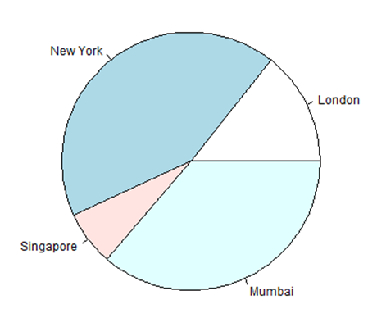
R - Pie Charts
Example
A very simple pie-chart is created using just the input vector and labels. The below script will create and save the pie chart in the current R working directory.
# Create data for the graph.
x <- c(21, 62, 10, 53)
labels <- c("London", "New York", "Singapore", "Mumbai")
# Give the chart file a name.
png(file = "city.png")
# Plot the chart.
pie(x,labels)
# Save the file.
dev.off()

Slide 12
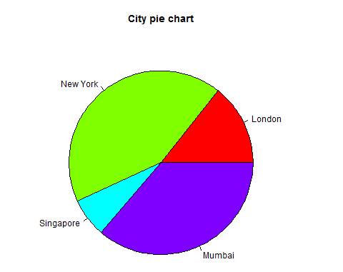
Pie Chart Title and Colors
We can expand the features of the chart by adding more parameters to the function. We will use parameter main to add a title to the chart and another parameter is col which will make use of rainbow colour pallet while drawing the chart. The length of the pallet should be same as the number of values we have for the chart. Hence we use length(x).
Example
The below script will create and save the pie chart in the current R working directory.
# Create data for the graph.
x <- c(21, 62, 10, 53)
labels <- c("London", "New York", "Singapore", "Mumbai")
# Give the chart file a name.
png(file = "city_title_colours.jpg")
# Plot the chart with title and rainbow color pallet.
pie(x, labels, main = "City pie chart", col = rainbow(length(x)))
# Save the file.
dev.off()

Slide 13
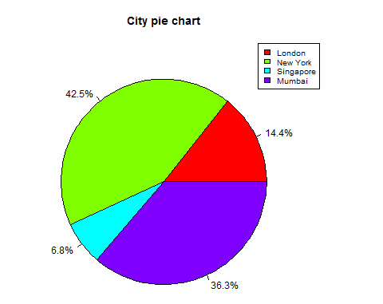
Slice Percentages and Chart Legend
We can add slice percentage and a chart legend by creating additional chart variables.
# Create data for the graph.
x <- c(21, 62, 10,53)
labels <- c("London","New York","Singapore","Mumbai")
piepercent<- round(100*x/sum(x), 1)
# Give the chart file a name.
png(file = "city_percentage_legends.jpg")
# Plot the chart.
pie(x, labels = piepercent, main = "City pie chart",col = rainbow(length(x)))
legend("topright", c("London","New York","Singapore","Mumbai"), cex = 0.8, fill = rainbow(length(x)))
# Save the file.
dev.off()

Slide 14
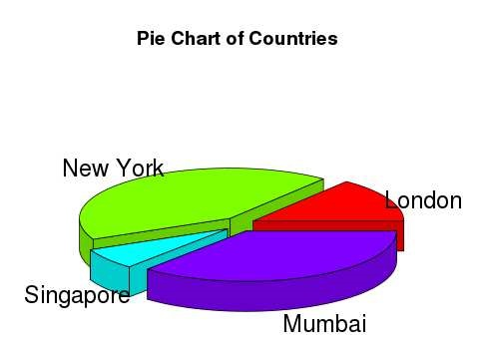
3D Pie Chart
A pie chart with 3 dimensions can be drawn using additional packages. The package plotrix has a function called pie3D() that is used for this.
# Get the library.
library(plotrix)
# Create data for the graph.
x <- c(21, 62, 10,53)
lbl <- c("London","New York","Singapore","Mumbai")
# Give the chart file a name.
png(file = "3d_pie_chart.jpg")
# Plot the chart.
pie3D(x,labels = lbl,explode = 0.1, main = "Pie Chart of Countries ")
# Save the file.
dev.off()

